Slide 1

The Secure Messaging Application
By Tyler Wallingford

Slide 2
Introduction
Hello everyone, and welcome to my presentation on the Secure Messaging Application I've developed. Over the next few minutes, I'll demonstrate the final working project, provide an overview of my implementation approach, discuss key GUI elements and functionalities, and highlight an interesting feature in the code that was particularly challenging to implement.

Slide 3
Demonstration of the Application at work
Here we will provide a demonstration of the application and its functions.
Link to Screen cast:
https://www.loom.com/share/8b60bf866157403c9276e63c700466af?sid=fdec6e13-c005-43c7-9474-a5c650086a3f

Slide 4
Overview of the Approach
Technologies used:
PHP(for server-side scripting), MySQL(for database management), JavaScript(for client-side intersations), and HTML/CSS(for frontend design and style)
Security Measures:
Password Hashing using password_hash(), Session Management with session_start(), Prepared Statements to prevent SQL injection, CSRF Tokens for form submission security, Content Security Policy (CSP) headers to mitigate XSS attacks
Message Encryption:
AES-128-CBC Encryption Algorithm, Encryption Key and IV Management, Encrypt Messages before storing in the database, Decrypt Messages upon retrieval for display
User Interface Elements: Responsive Design using CSS, Navigation Bar with user info and settings, Sidebar with Tabs for, Messages and Contacts, Theme Customization (Light and Dark modes)

Slide 5
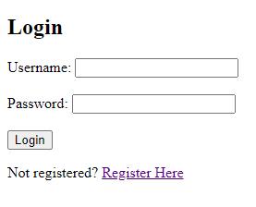

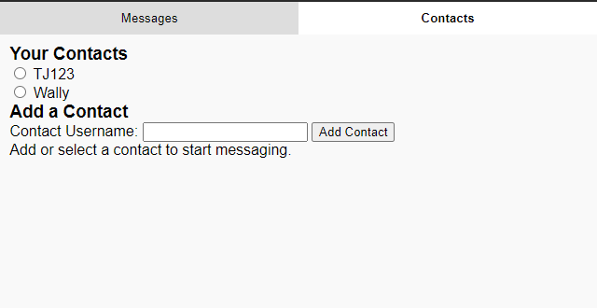
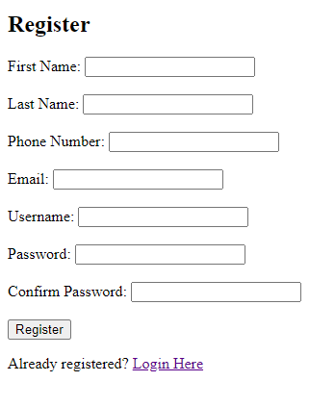

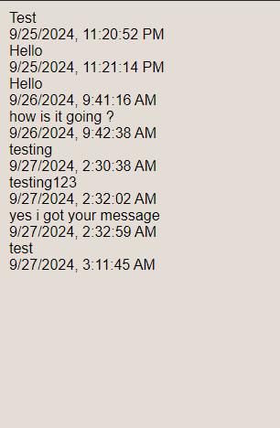
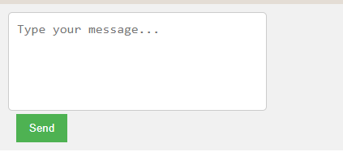

GUI Elements
Login Page
Contacts tab
Setting/logged in user
Registration
Messages area
Input message area/send
Message/Conversation
Settings popup

Slide 6
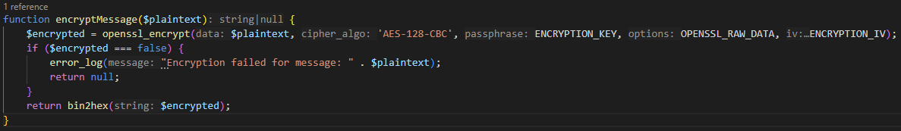
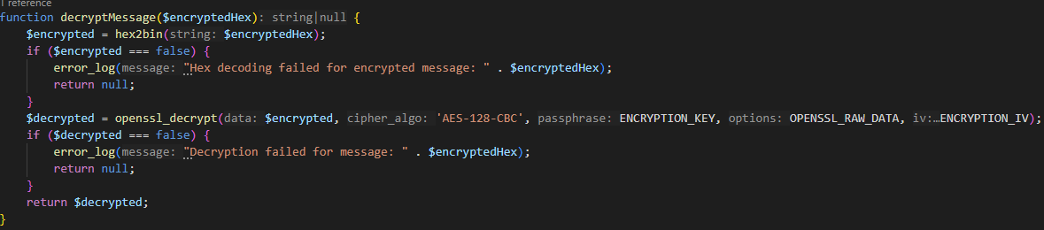
An Interesting Functionality
Function for Encryption
An interesting and challenging feature I implemented is the message encryption shown in encryption.php
The objective of the approach was to ensure that messages are securely stored in the database by encrypting them before storage and decrypting upon retrieval.
Challenges faced:
Static IV Usage: I am using a static Initialization Vector, which I know is not ideal for security. The best practice is to use a random IV for each encryption operation.
Solution: Due to the project constraints, I continued with a static IV but for security purposes I would ensure that both the key and IV are securely managed and not exposed.
Function for Decryption

Slide 7
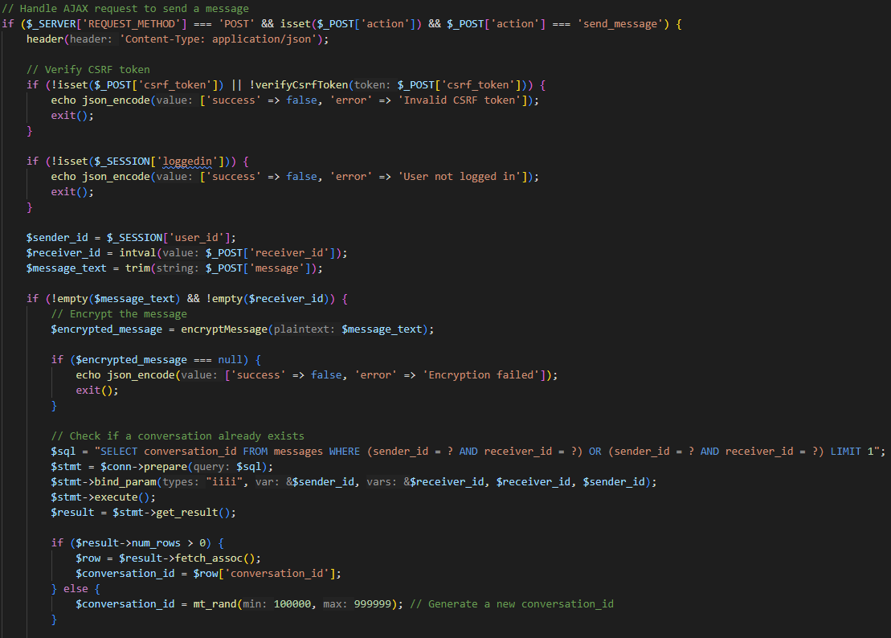
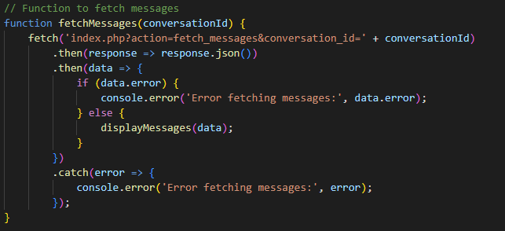
Another Major Functionality of the Application
Sending Messages (Index.php- server-side):
Main Concepts:
Security Checks: Verifies CSRF tokens
Encryption: Uses the encryptMessage() function to encrypt the message .
Database Interaction: Inserts the encrypted message into the specific database table.
Fetching Messages (Index.php- server-side) :
Main Concepts:
Authentication check: To ensure the user is logged in.
Message retrieval: Fetches messages associated with logged in users ID.
Decryption: Will decrypt the message before sending them to the client.
Sending Messages(script.js – Client-Side):
Main Concepts:
AJAX Request: Sends the message data to the server without reloading the webpage.
Response Handling: Updates the UI based on the server’s response.
CSRF Protection: Includes the CSRF token for security.
Fetching Messages (script.js – Client-Side):
Main concepts:
AJAX Request: To periodically fetch new messages for real-time updates.
Dynamic UI Update: Renders the received messages in the chat interface.
Error Handling: Logs any errors encountered during the request.
Sending Messages (Index.php- server-side)
Fetching Messages (script.js – Client-Side)

Slide 8
Thank you !
Thank you for your attention. This project has been an excellent opportunity to apply and expand my skills in web and security development. I'm happy to answer any questions you may have

Slide 9

Q&A
I'd be glad to address any questions or hear your feedback!

Slide 10
References:
Daemen, J., & Rijmen, V. (2002). AES and the Wide Trail Design Strategy. In B. S. K. Koc (Ed.), Cryptographic Hardware and Embedded Systems — CHES 2002 (pp. 108–109). Springer. https://doi.org/10.1007/3-540-36400-5_8
Ferguson, N., Schneier, B., & Kohno, T. (2010). Cryptography Engineering: Design Principles and Practical Applications. Wiley Publishing.
PHP.net. (n.d.). openssl_encrypt. PHP Manual. Retrieved from https://www.php.net/manual/en/function.openssl-encrypt.php

